Slide 1
AOP

Slide 3
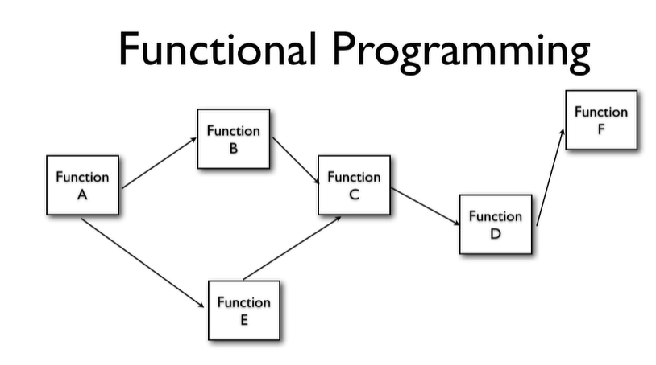

Slide 4
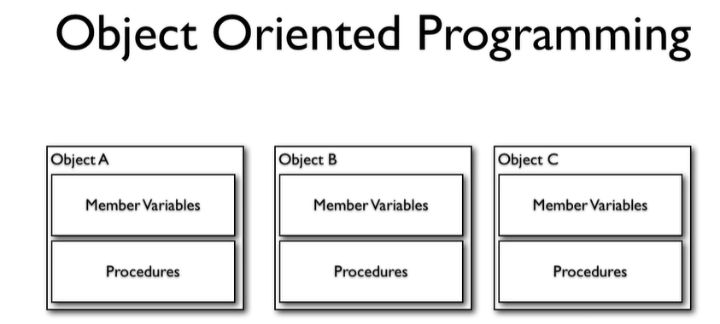

Slide 5
Aspect-Oriented Programming (AOP) is a programming paradigm that aims to increase modularity by allowing the separation of cross-cutting concerns. Cross-cutting concerns are aspects of a program that affect multiple parts of the application, such as logging, security, or transaction management.
In AOP, these cross-cutting concerns are modularized into separate units called aspects .

Slide 6
What is a cross-cutting concern?
A cross-cutting concern is a functionality that is tangled with business code, which usually cannot be separated from the business logic. Auditing, security, and transaction management are good examples of cross-cutting concerns.
These are good candidates for separation using aspects because there is no design pattern that would allow writing the code in such a way that they would be separated from the business logic.

Slide 7
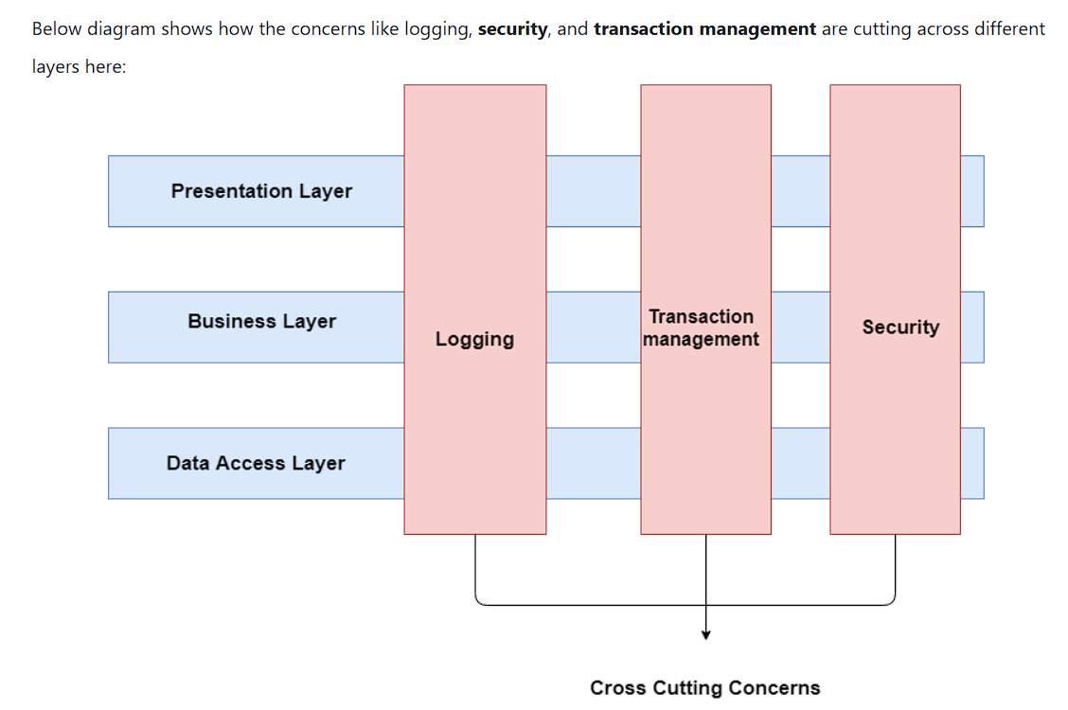

Slide 8
Advice : This is the action taken by an aspect at a particular join point. There are five types of advice:
Before : Executed before the method call.
After : Executed after the method call, regardless of its outcome.
AfterReturning : Executed after the method returns a result, but not if an exception occurs.
Around : Surrounds the method execution, allowing you to control the method execution and its result.
AfterThrowing : Executed if the method throws an exception.

Slide 9
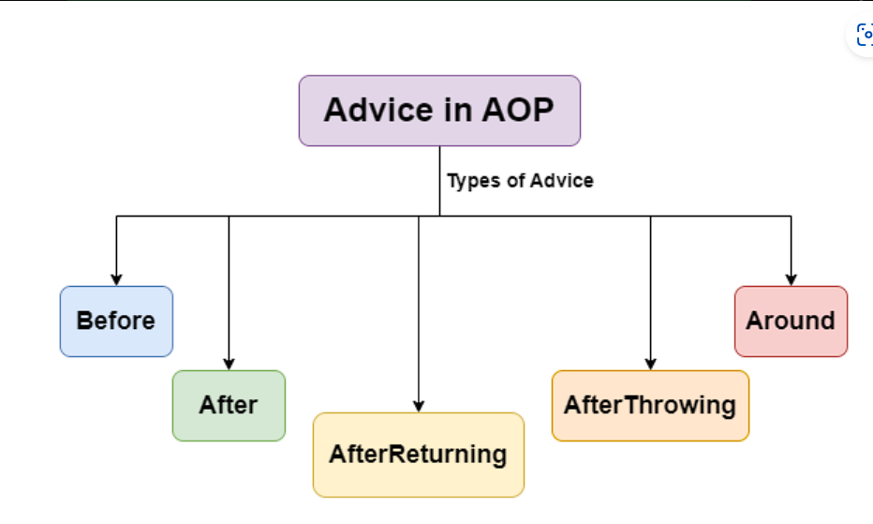

Slide 10
Pointcut : The @Pointcut annotation defines the pointcut where advice is applied.
Pointcut : The @Pointcut annotation defines the pointcut where advice is applied.
Pointcut : The @Pointcut annotation defines the pointcut where advice is applied.
Join Point : A specific point in the execution of a program, such as method execution or exception handling, where an aspect can be applied.
Pointcut : A predicate that matches join points. A pointcut expression specifies where an advice should be applied.
Weaving : The process of linking aspects with the target object. Weaving can occur at compile-time, load-time, or runtime. Spring AOP performs runtime weaving using proxy-based mechanisms.

Slide 11
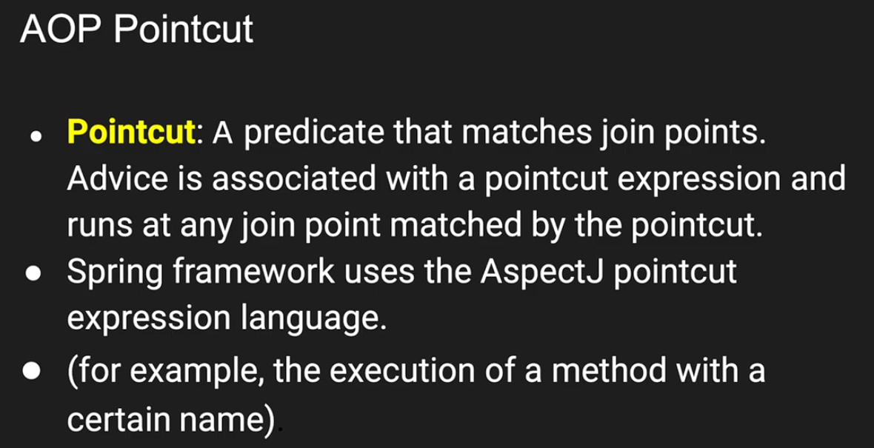

Slide 12
